Slide 1
O11y with Toli
101 - May 2022
What is observability?

Slide 2
O11y with Toli
June
May 2022

Slide 3
Observability
o11y

Slide 4
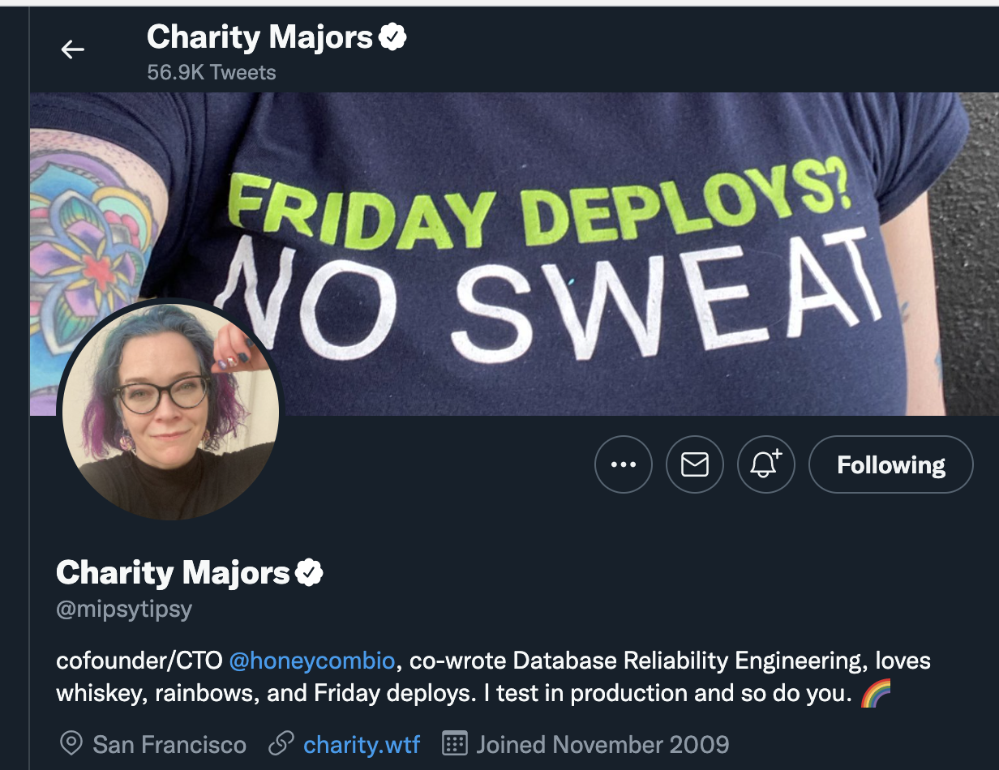
o11y
Notes:
Jose covers:
-

Slide 5
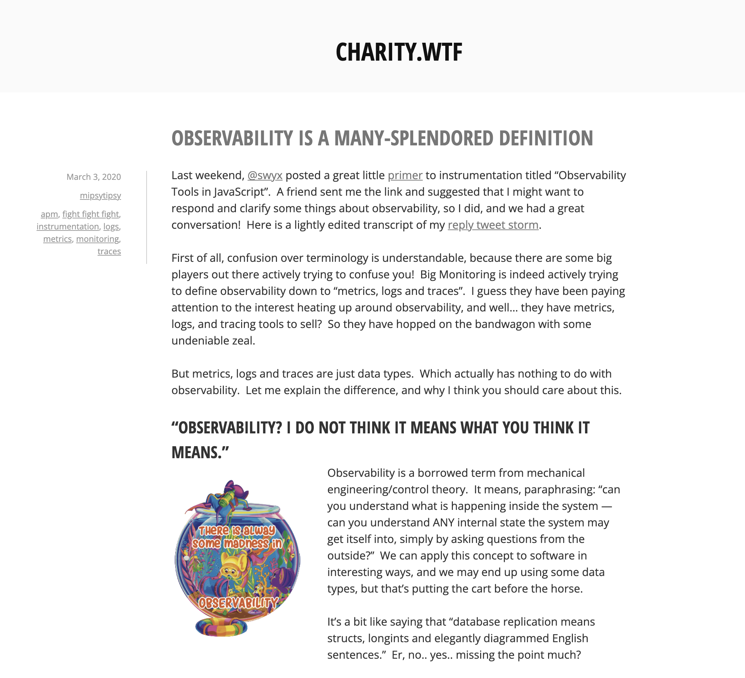

Observability
Notes:
I'd highly encourage anyone interested in delving deep into observability to look up Charity's blog posts or rants on twitter.
I've linked a representative example here well worth reading

Slide 6
That’s it. Go and read Charity’s rants.

Slide 7
(I read all her rants)

Slide 8
(and her blog posts)

Slide 9
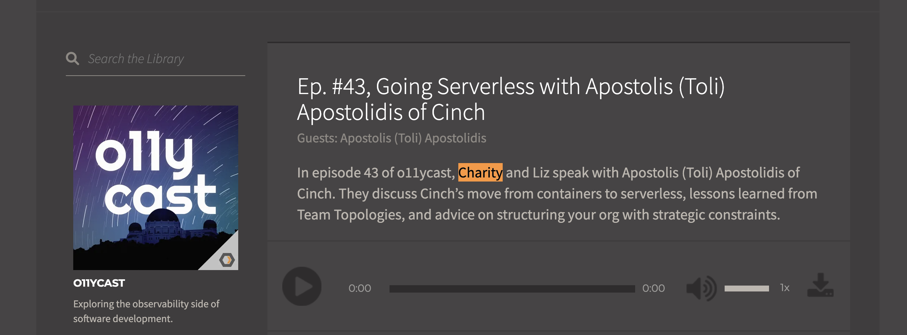
I even chatted to her about o11y @ cinch.

Slide 10
Why should care about o11y?

Slide 11
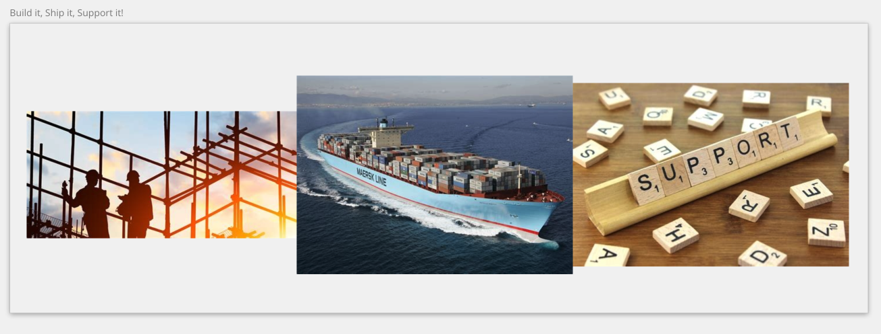
Build it, Ship it, Support it
Notes:
We had demonstrated that we were good at building and shipping, but we were immature in supporting!

Slide 12
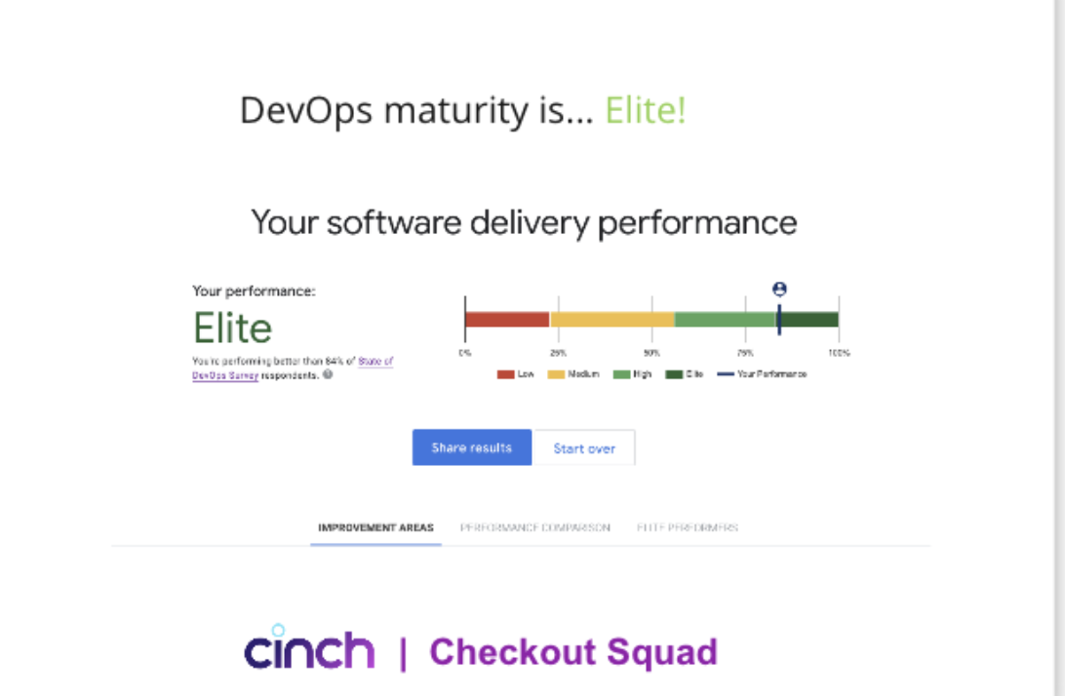
DevOps Maturity
Notes:
We had demonstrated that we were good at building and shipping, but we were immature in supporting!

Slide 13
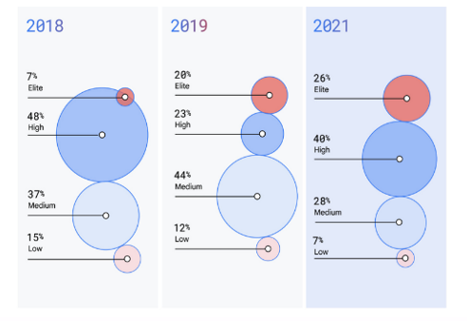
The industry has advanced
Notes:
Since we started thinking about cinch as an idea (circa start of 2019) and we were reading the excellent Accelerate book and the DORA research, the industry has advanced. An organization that was elite in 2018 was only 7% of the total organizations. As per the latest State of DevOps report (only published in September 2021), 26% of organizations are elite in terms of software delivery performance.

Slide 14
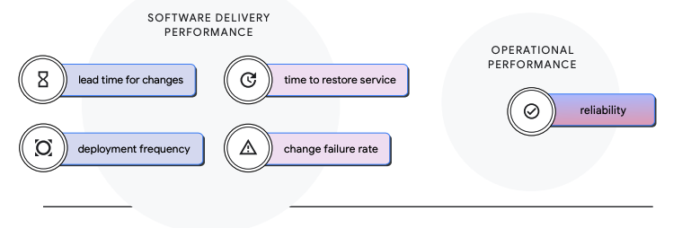
The fifth metric: Reliability*
* 2021 Accelerate State of DevOps Report
Notes:
Software delivery is measured by the 4 metrics, two indicating speed and two indicating quality
but Reliability - the fifth metric – measures operational performance.

Slide 15
Reliability = serverless + o11y*
*observability
Notes:
Reliability is an outcome of a series of things:
Serverless provides some reliability out of the box
Good software Delivery practices & good architectural design contribute as well
Since we had chosen serverless, what we could focus on is improving our observability & monitoring
We needed to know when something breaks and more importantly why.
We also need to know how well our services are performing against the business promises we had made!)

Slide 16
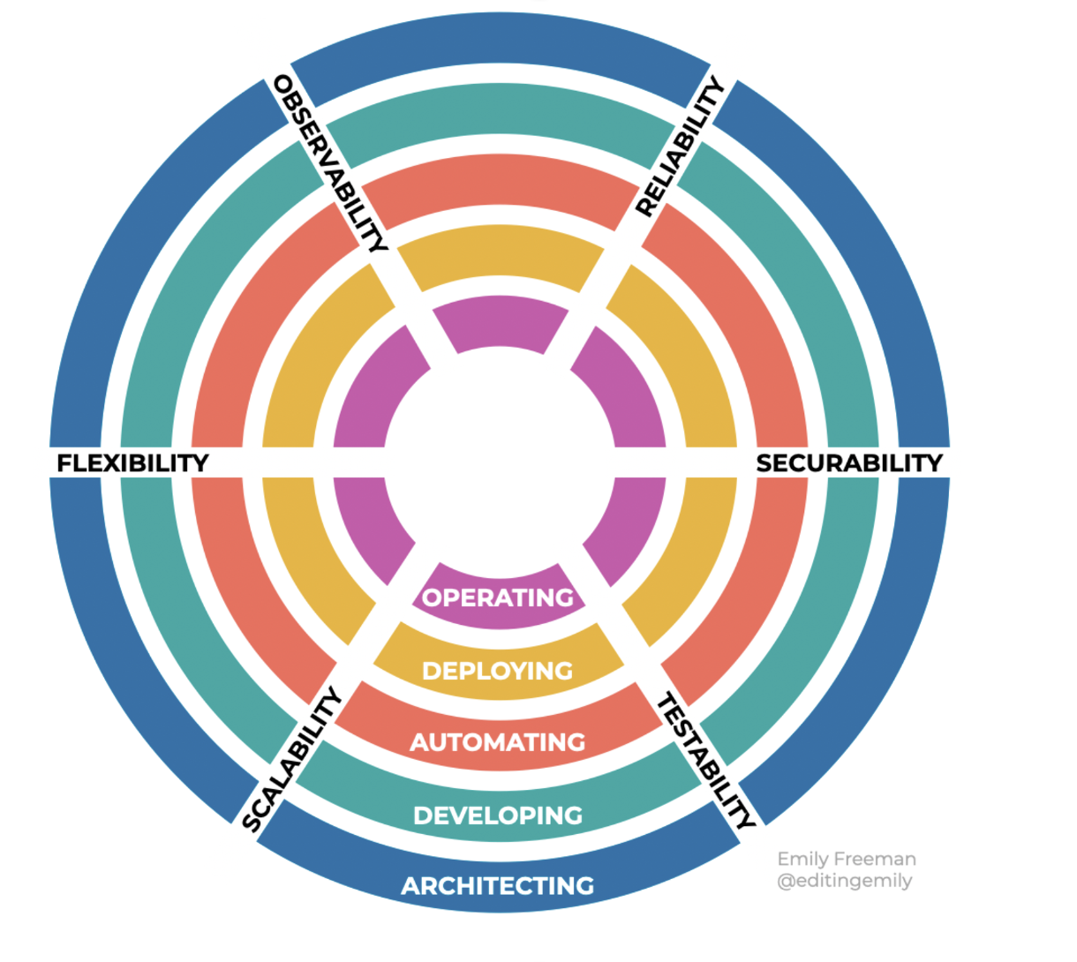
Observability matters.
👉
👉
👉
👉
👉

Slide 17
“How do you know your change is working in production?”

Slide 18
Software that can’t be observed, can’t be improved.

Slide 19
Isn’t o11y logs and alerts?

Slide 20

Isn’t o11y logs and alerts?

Slide 21

Isn’t o11y logs and alerts?

Slide 22

Isn’t o11y logs and alerts?

Slide 23
What are logs?

Slide 24
Logs* record events taking place in the execution of a system in order to provide an audit trail...
*https://en.wikipedia.org/wiki/Logging_(software)

Slide 25
…that can be used to understand the activity of the system and to diagnose problems*
*https://en.wikipedia.org/wiki/Logging_(software)

Slide 26
”Logs are the problem child of observability”

Slide 27
What are alerts?

Slide 28
Alerts* help us to identify ongoing or upcoming issues that we may get within our data center software systems…
*https://social.technet.microsoft.com/wiki/contents/articles/53579.scom-alert-basics.aspx

Slide 29
…It is important to fully understand the meaning of the alert(s) that we receive before taking any action
*https://social.technet.microsoft.com/wiki/contents/articles/53579.scom-alert-basics.aspx

Slide 30
What is observability?

Slide 31
Observability is the ability to understand how a software system is behaving internally by evaluating its outputs.

Slide 32
O11y is a fancy word for “testing in production”

Slide 33
”O11y is about understanding the health of the customer transactions”

Slide 34
Observability is a state of the system.

Slide 35
Charity Majors coined borrowed the term for Software.

Slide 36
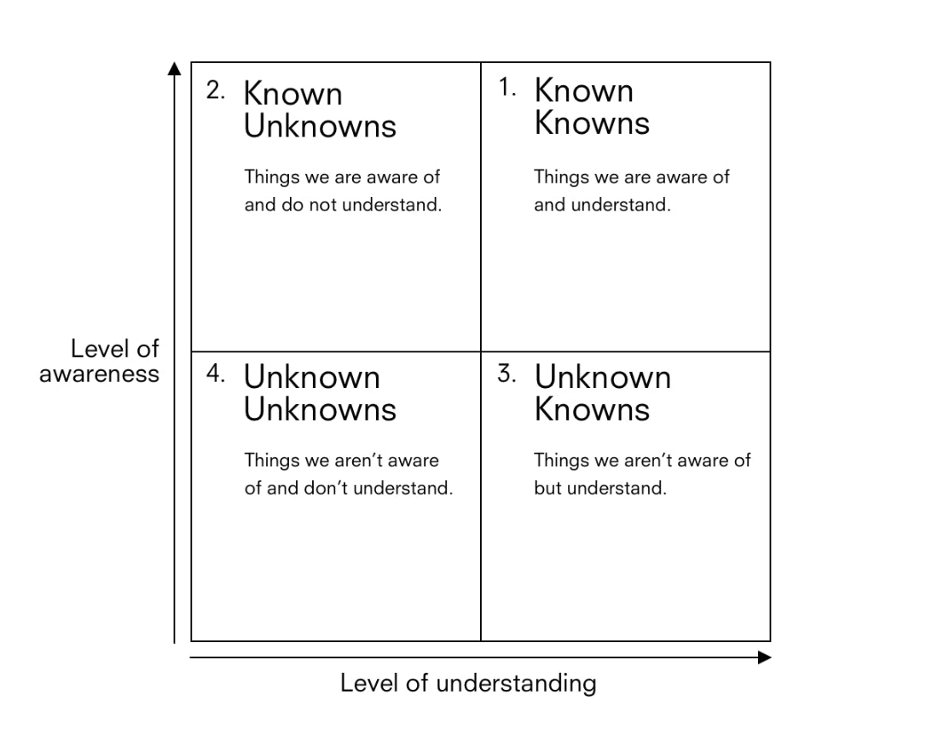

Slide 37
Mindset, tooling, instrumentation

Slide 38
OK, how do I make systems observable?

Slide 39
Making systems observable doesn’t happen by accident

Slide 40
Distributed systems make things a lot harder

Slide 41
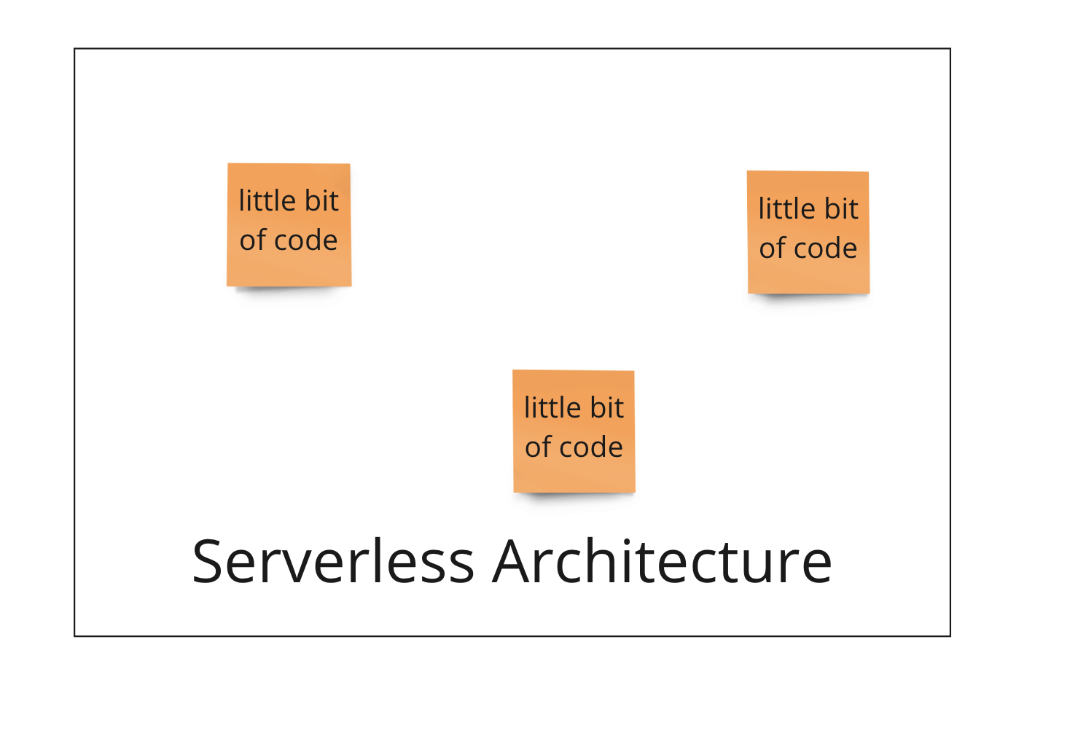
Little bits of code here & there
Notes:
A serverless architecture omits any concerns for where your code is deployed. You can imagine it as a blank box, within which you put your little bits of code.

Slide 42
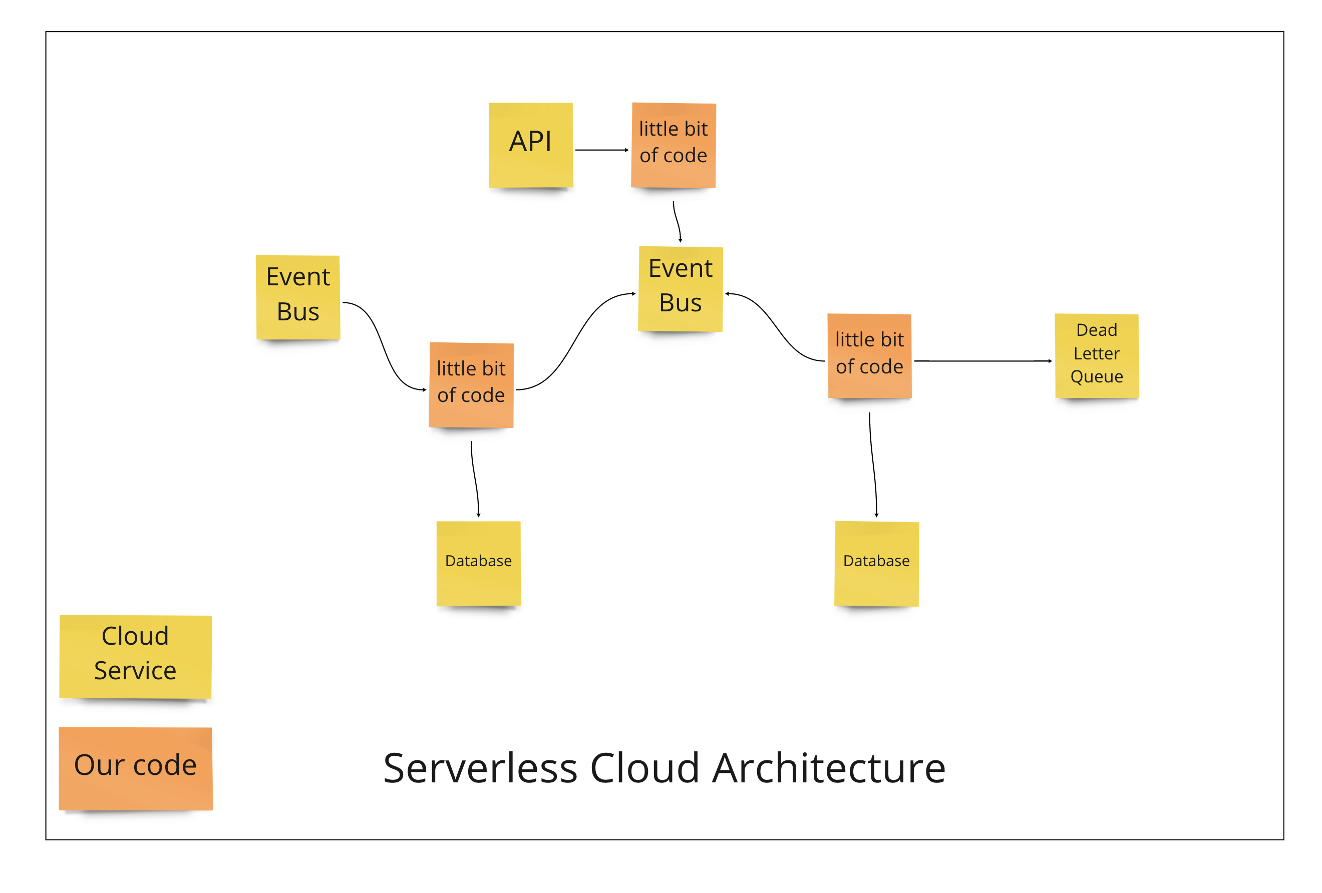
Notes:
And then you glue them together utilizing cloud serverelsss services

Slide 43
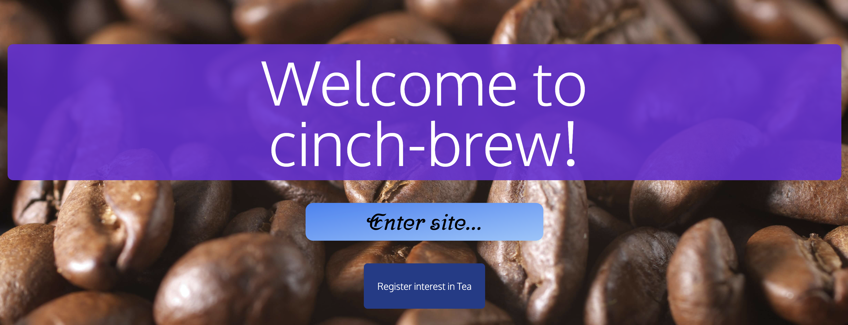
Notes:
Cinch brew is a fictional software system demonstrating good observability.
The system is designed with common cinch architectural patterns in mind – including backend and frontend.
An observability blueprint serves as the educational centre for good observability patterns and practices used at cinch. Its purpose is to offer guidance by way of working examples of common scenarios squads will come across whilst developing components

Slide 44
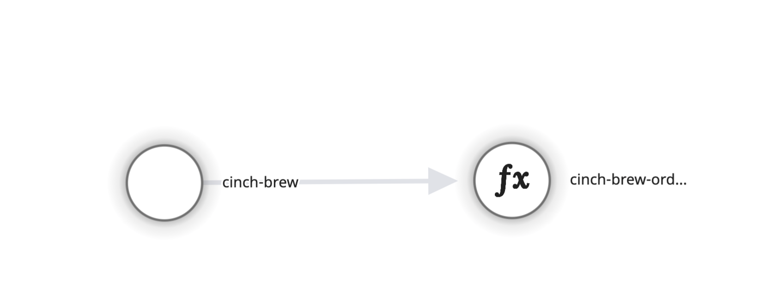
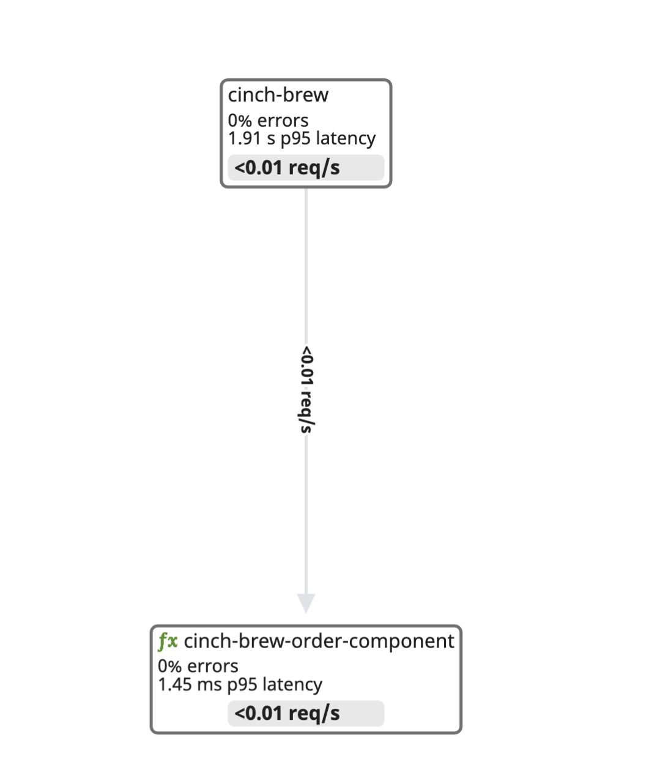

Slide 45
Front
Frontend

Slide 46
Backend

Slide 47
Requests, Errors, Duration

Slide 48
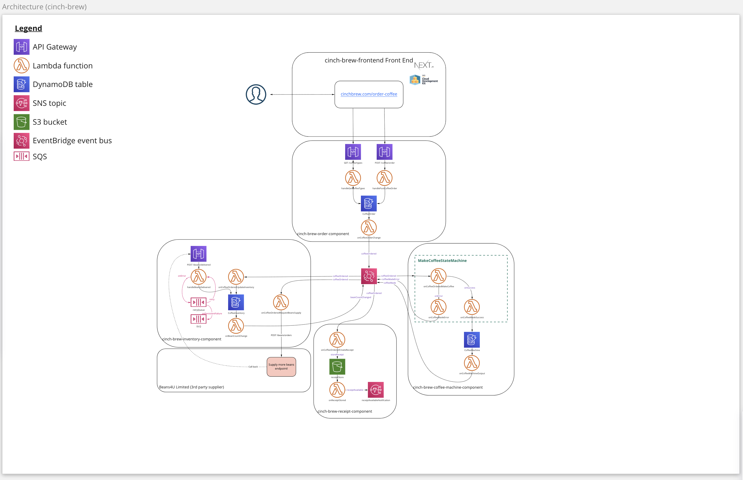
In (our fictitious) reality, systems are more complex

Slide 49
There is this bit too

Slide 50
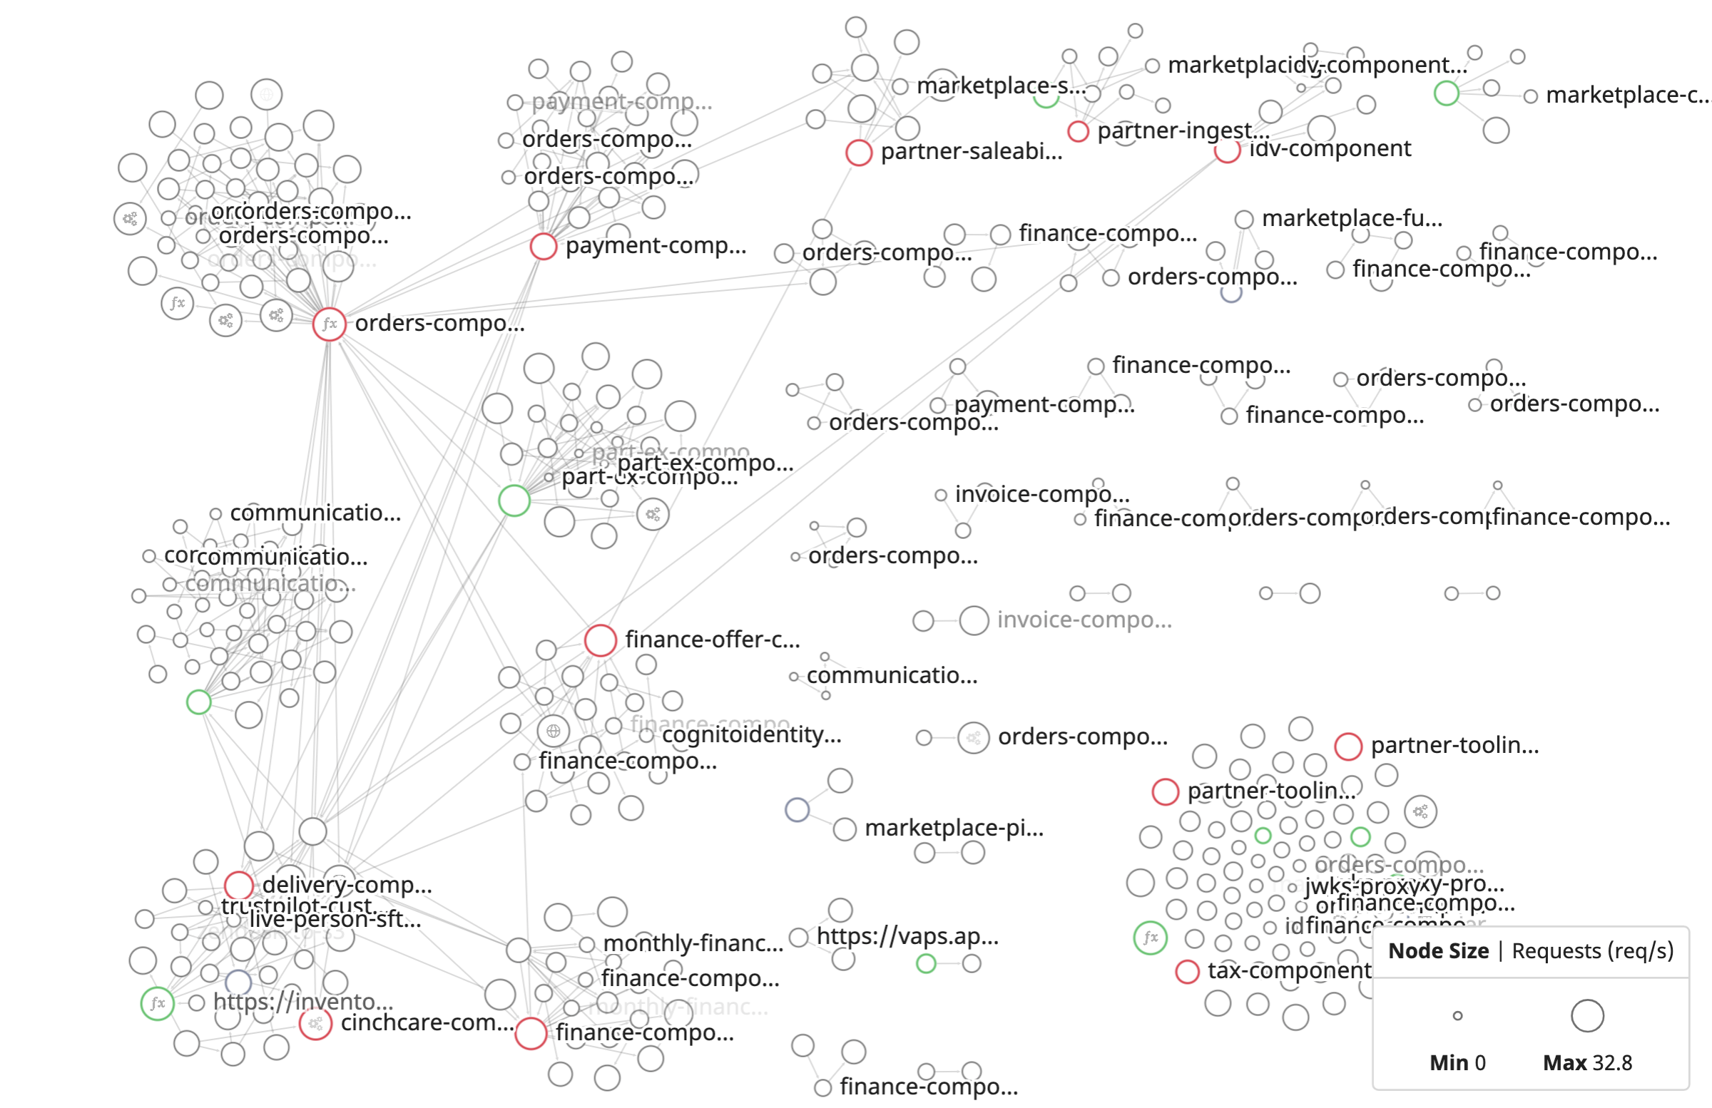

Serverless in production

Slide 51
Can you see the complexity creeping in?

Slide 52
OK, how do I make systems observable?

Slide 53
You start with code instrumentation

Slide 54
Instrumentation is the practice of systematically configuring our codebase to emit telemetry data…
Notes:
The first big aha moment with observability is to understand the concept of instrumentation: Don't just log free text. Think about what and how you can configure your codebase so that you end up with a rich telemetry dataset.

Slide 55
…that provide insights into how our code is exercised by data in production
Notes:
The first big aha moment with observability is to understand the concept of instrumentation: Don't just log free text. Think about what and how you can configure your codebase so that you end up with a rich telemetry dataset.

Slide 56
Instrument, don’t log
Auto-instrumentation
Custom instrumentation
Notes:
I am not talking about the old
'drop an agent on a server and let it collect metrics'
This goes beyond automation, there is a practice of custom instrumentation that elevates the observability of your systems.
Although, automation takes you a long way

Slide 57
Traces
Metrics
Logs
RUM
Events
CI Pipelines
CI Tests
Notes:
We are all familair with Logs, and possibly Metrics too.
But for highly observable systems, it's Traces and RUM Events that really make the difference. In our case, Traces, Metrics and Logs for our Lambdas, RUM events for the frontend. Btw, if you do end up going down the Charity Majors rabbit hole, you won't quite get this story. But I won't get into that.
[Most engineers are familiar with Logs, however lambda CloudWatch logs are not the easiest telemetry dataset to query.]

Slide 58
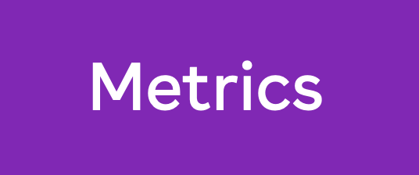
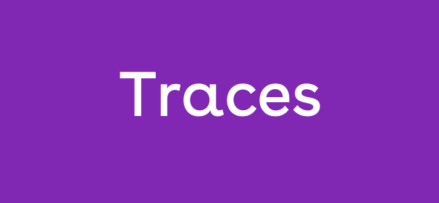
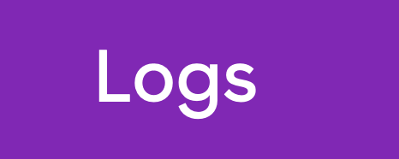
RUM

Slide 59
OK, so now I have loads of telemetry

Slide 60
How do I observe my systems

Slide 61
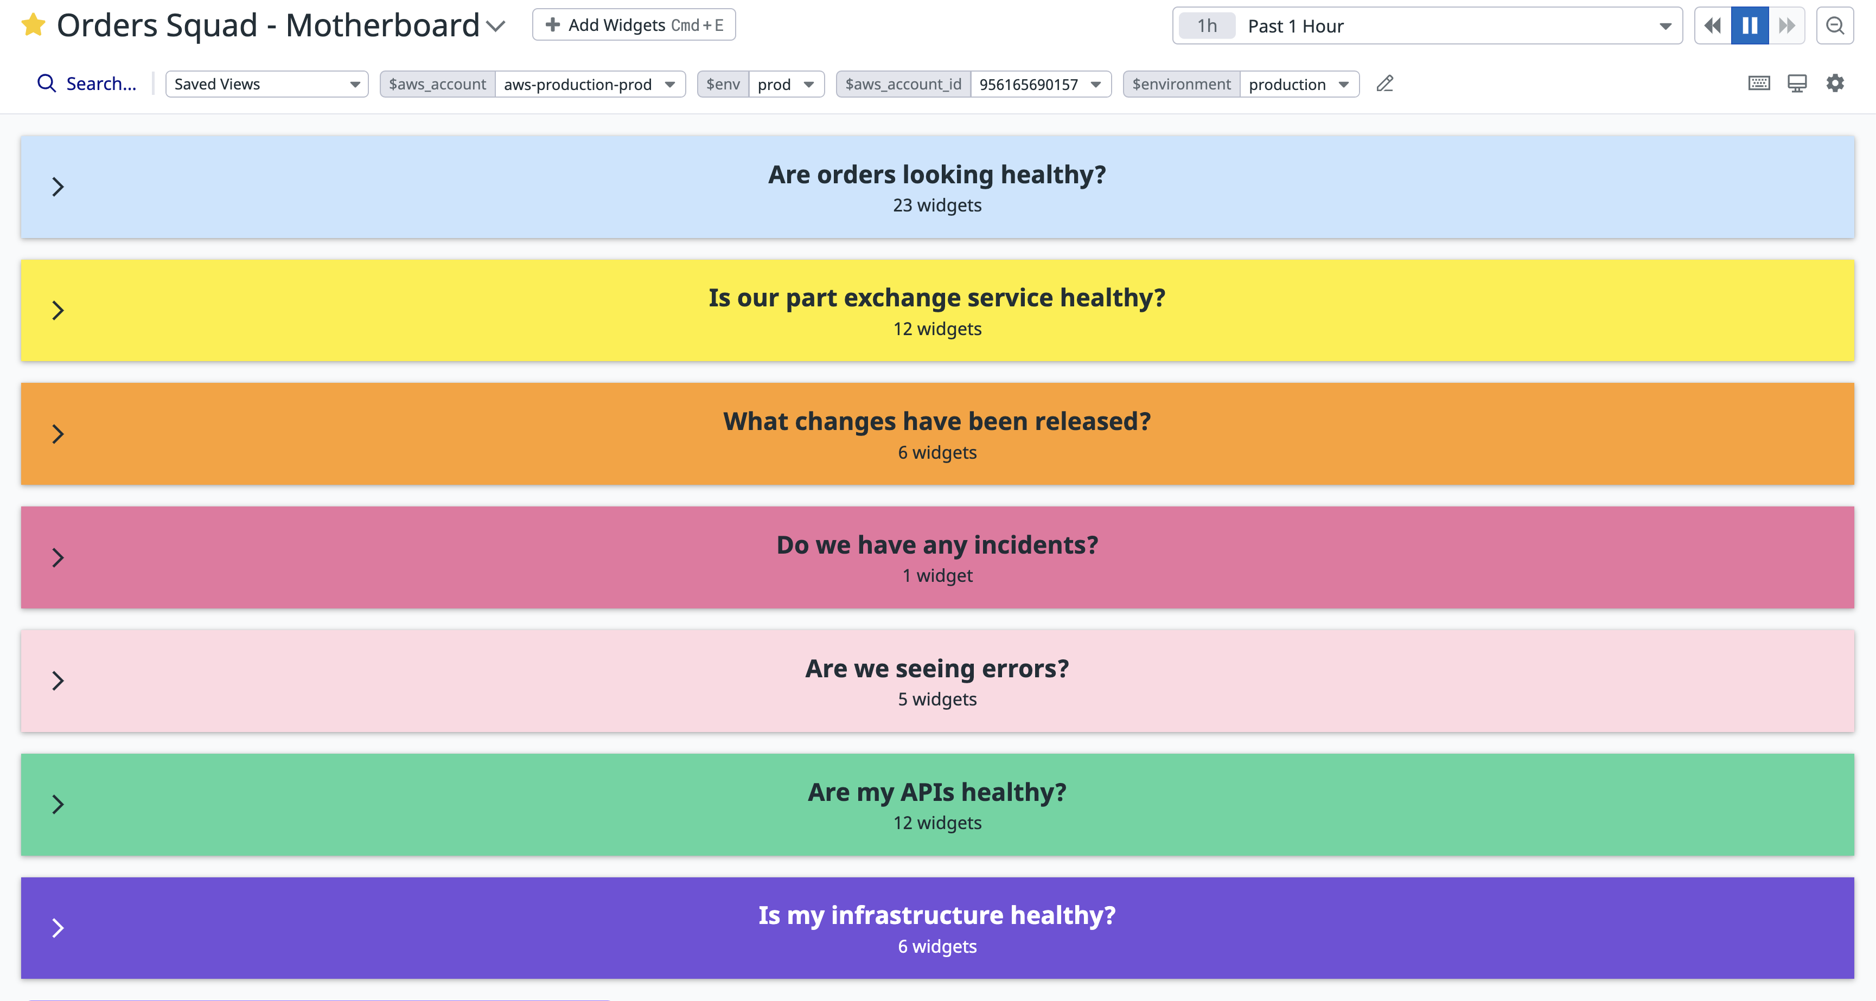
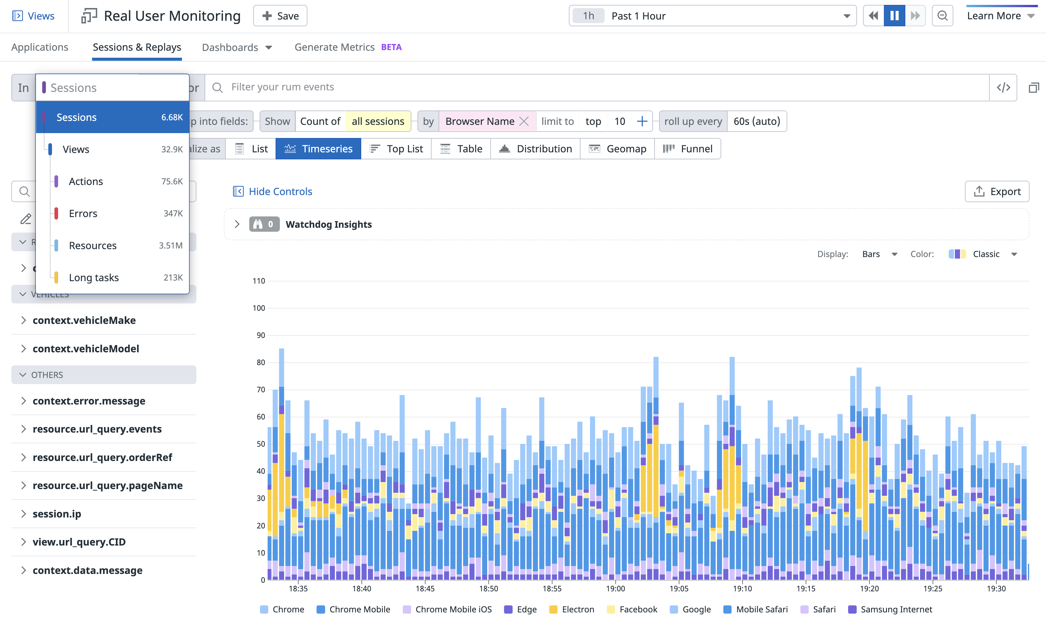
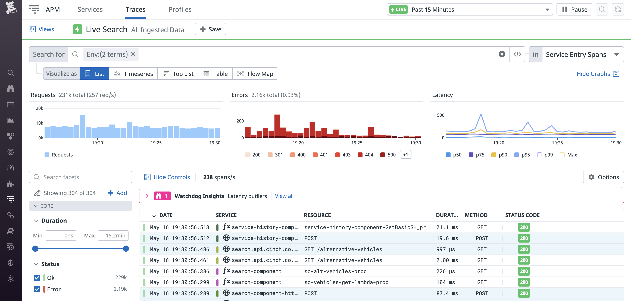

Slide 62
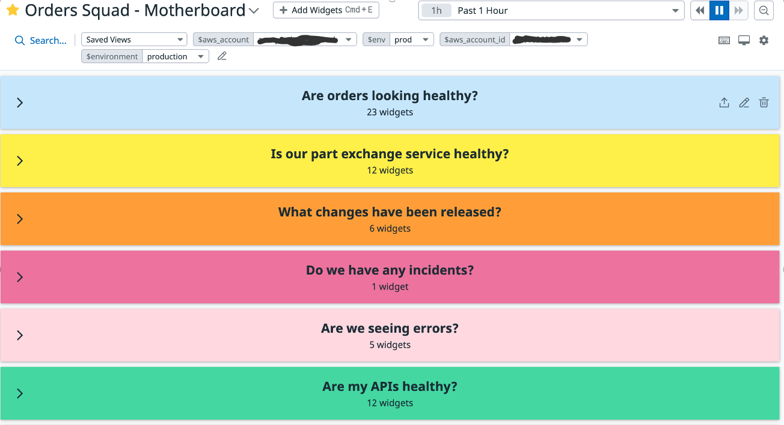
Inclusive

Slide 63
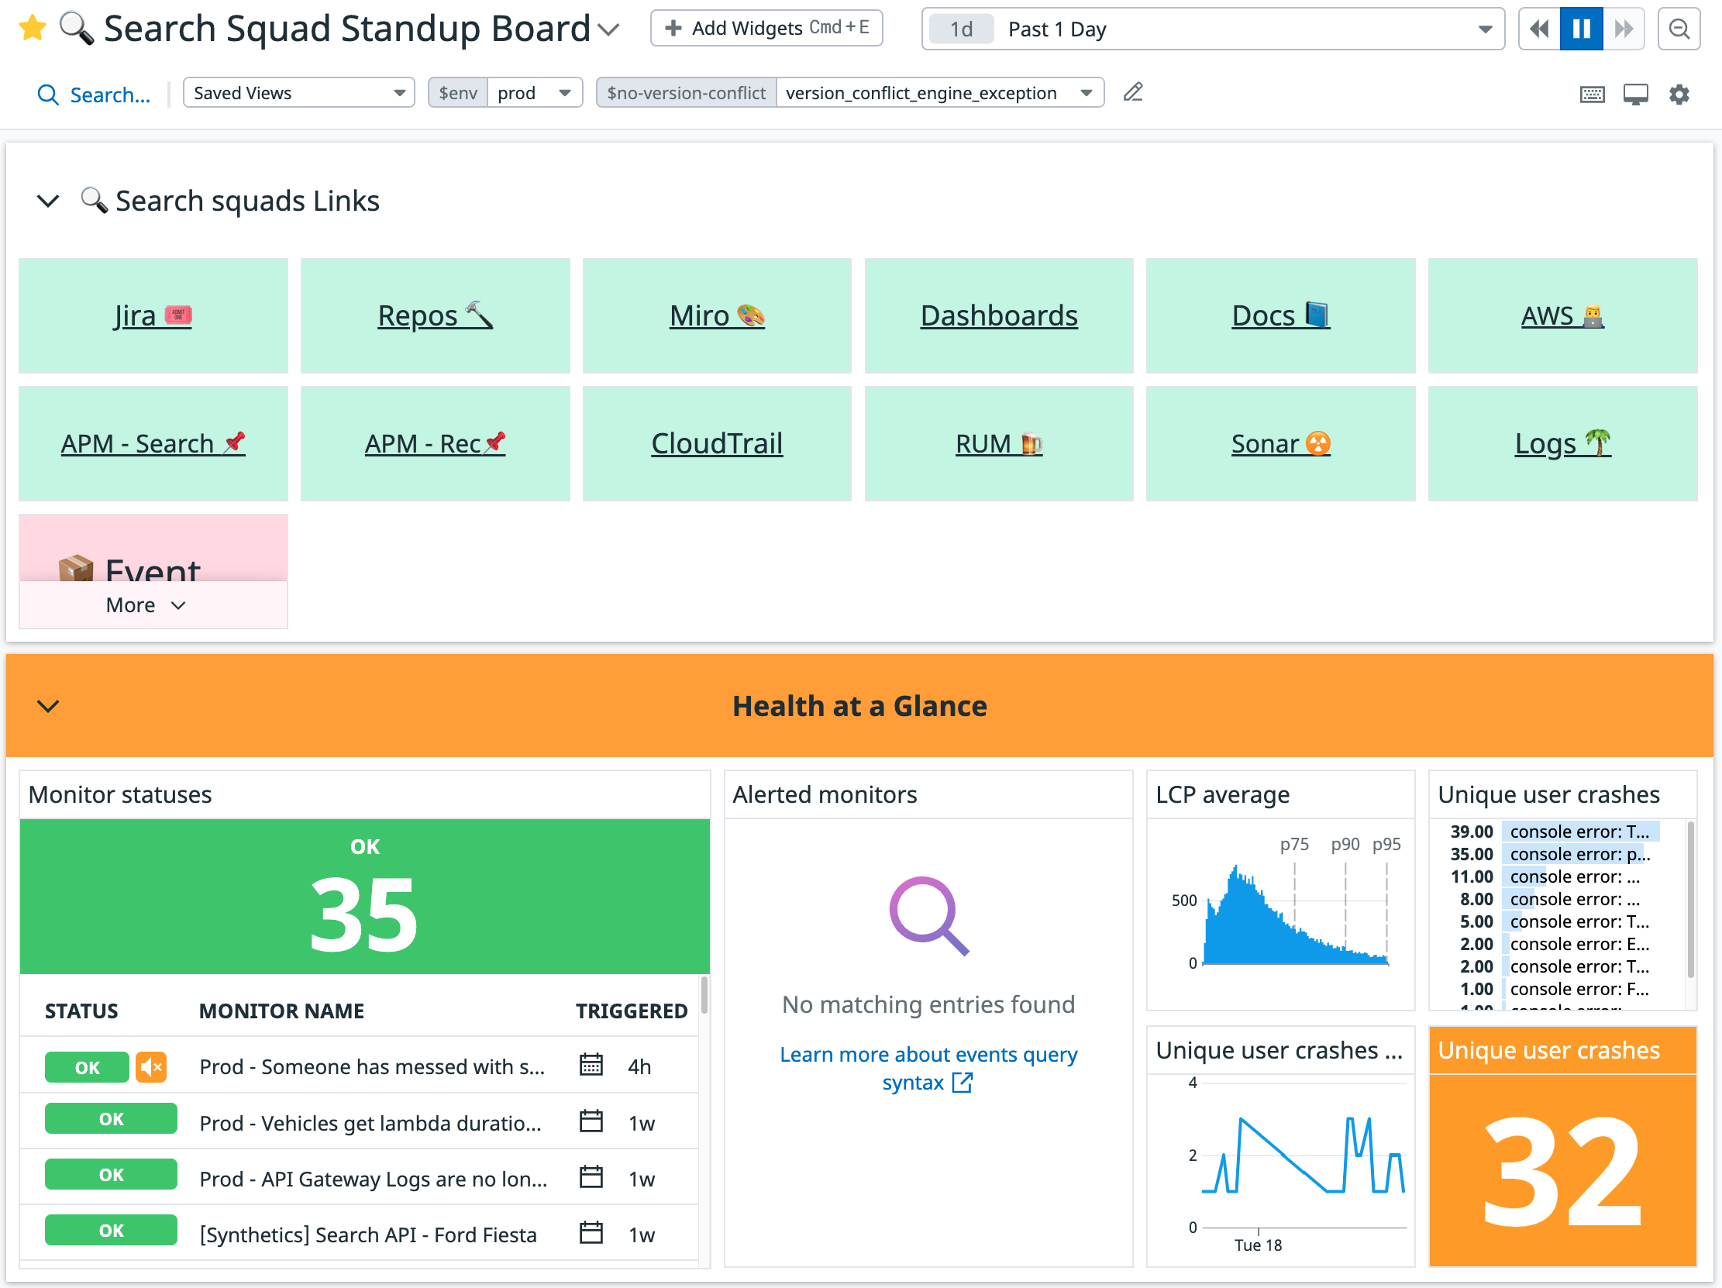
Comprehensive

Slide 64
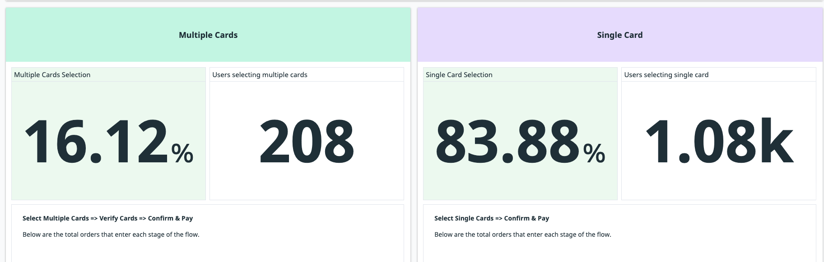
Customer centric

Slide 65
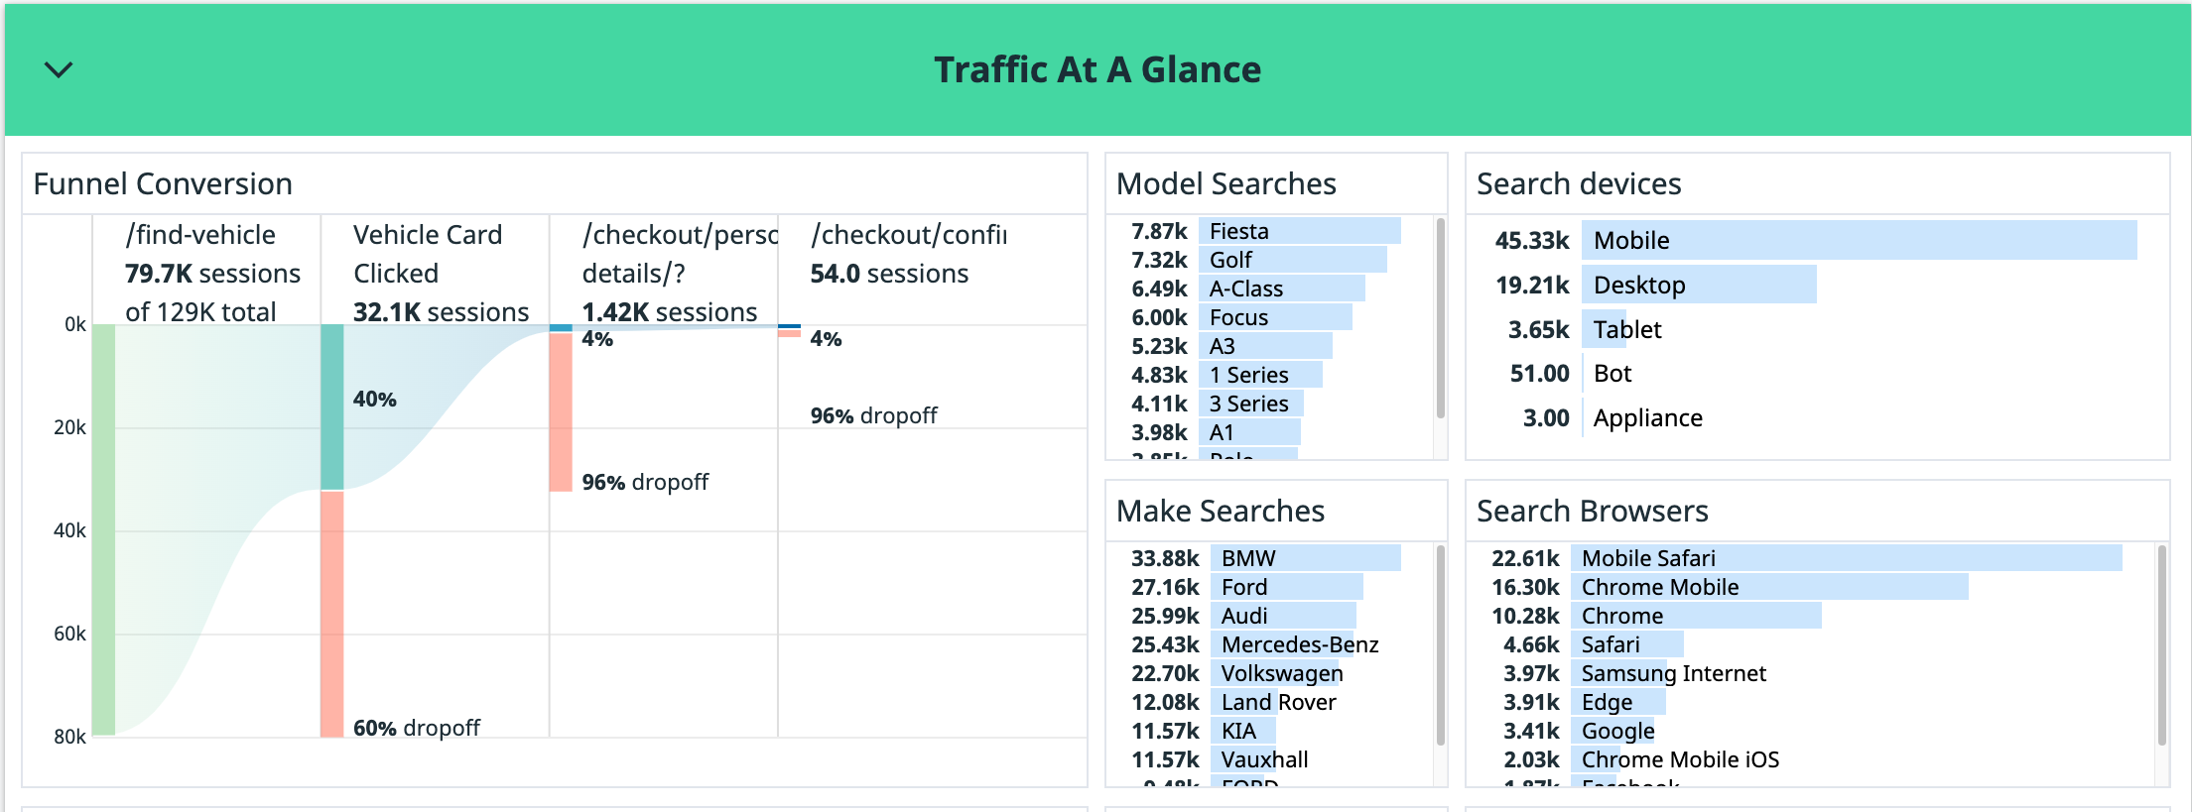
Funnel

Slide 66
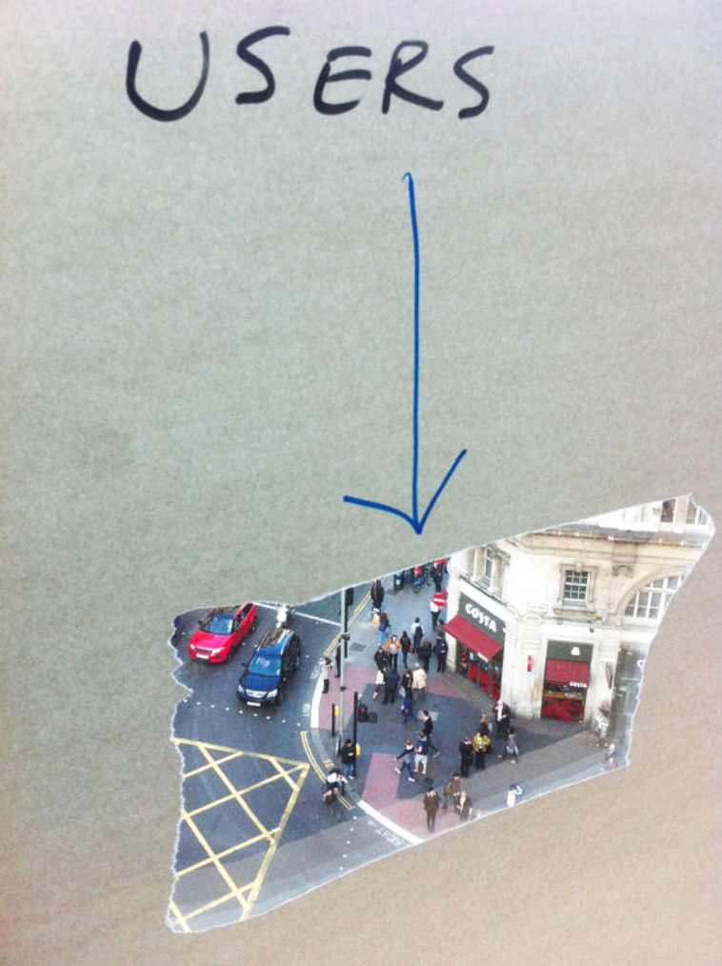
Funnel

Slide 67
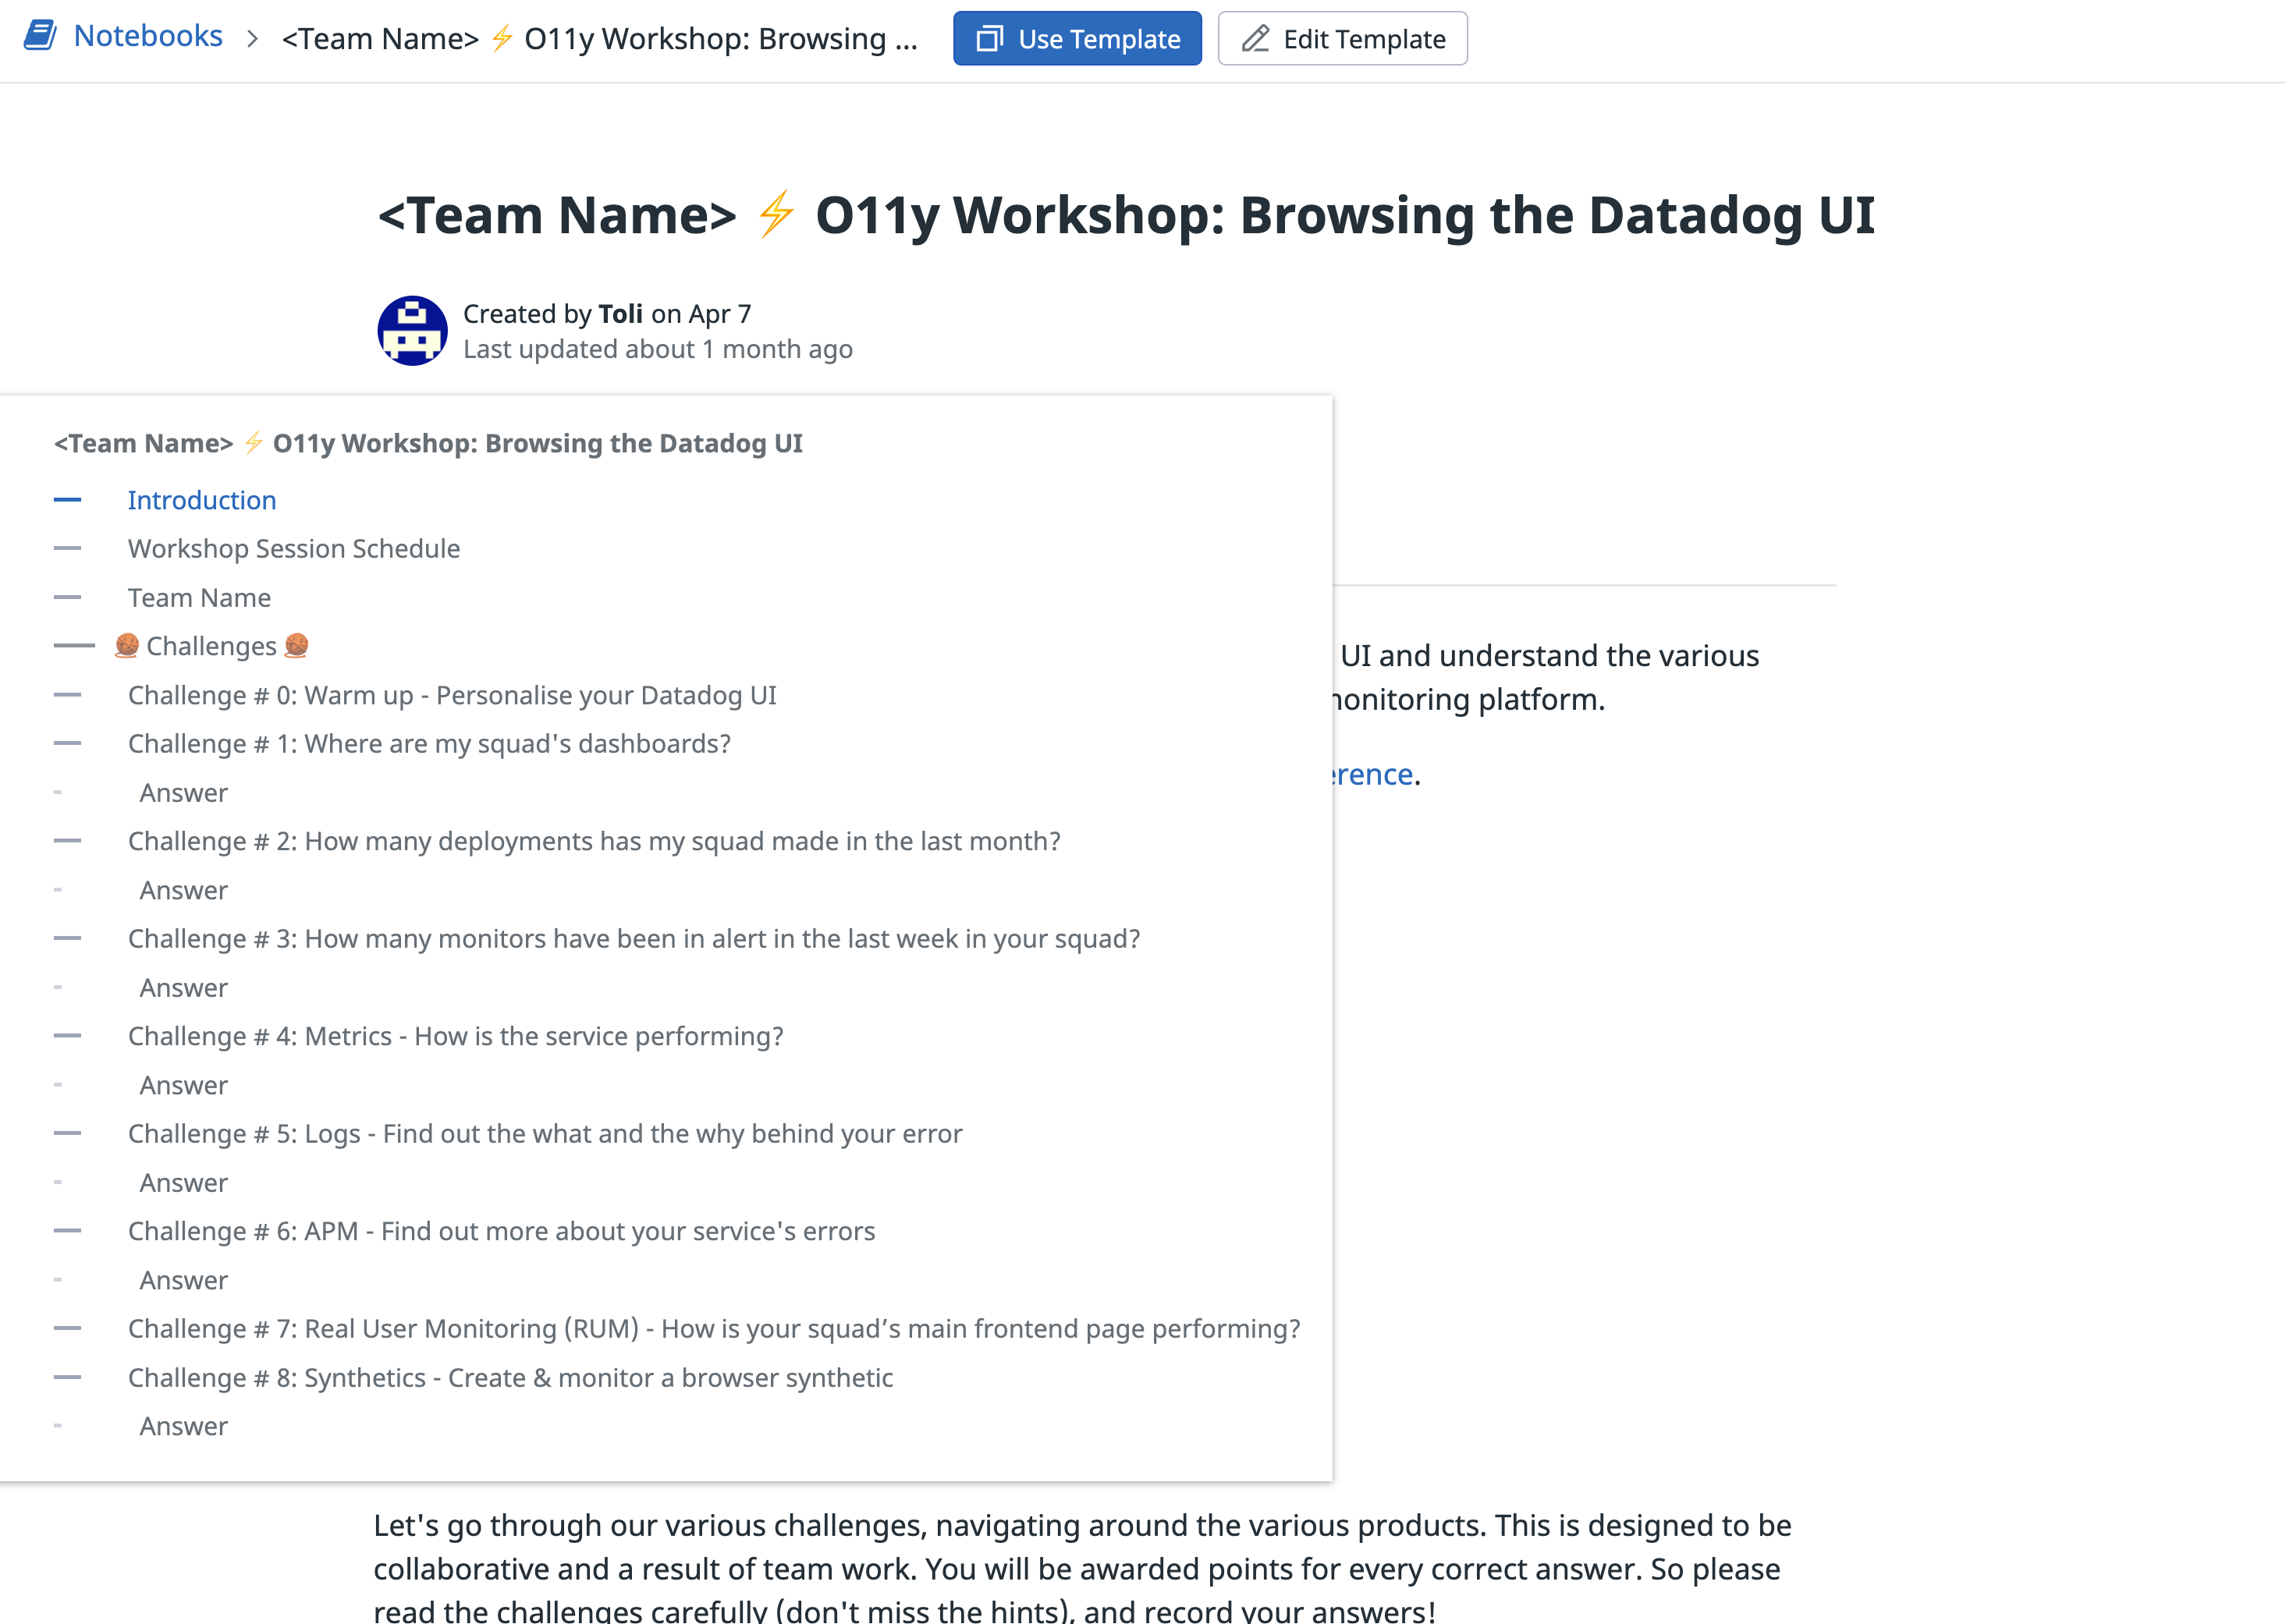
There’s a workshop!

Slide 68
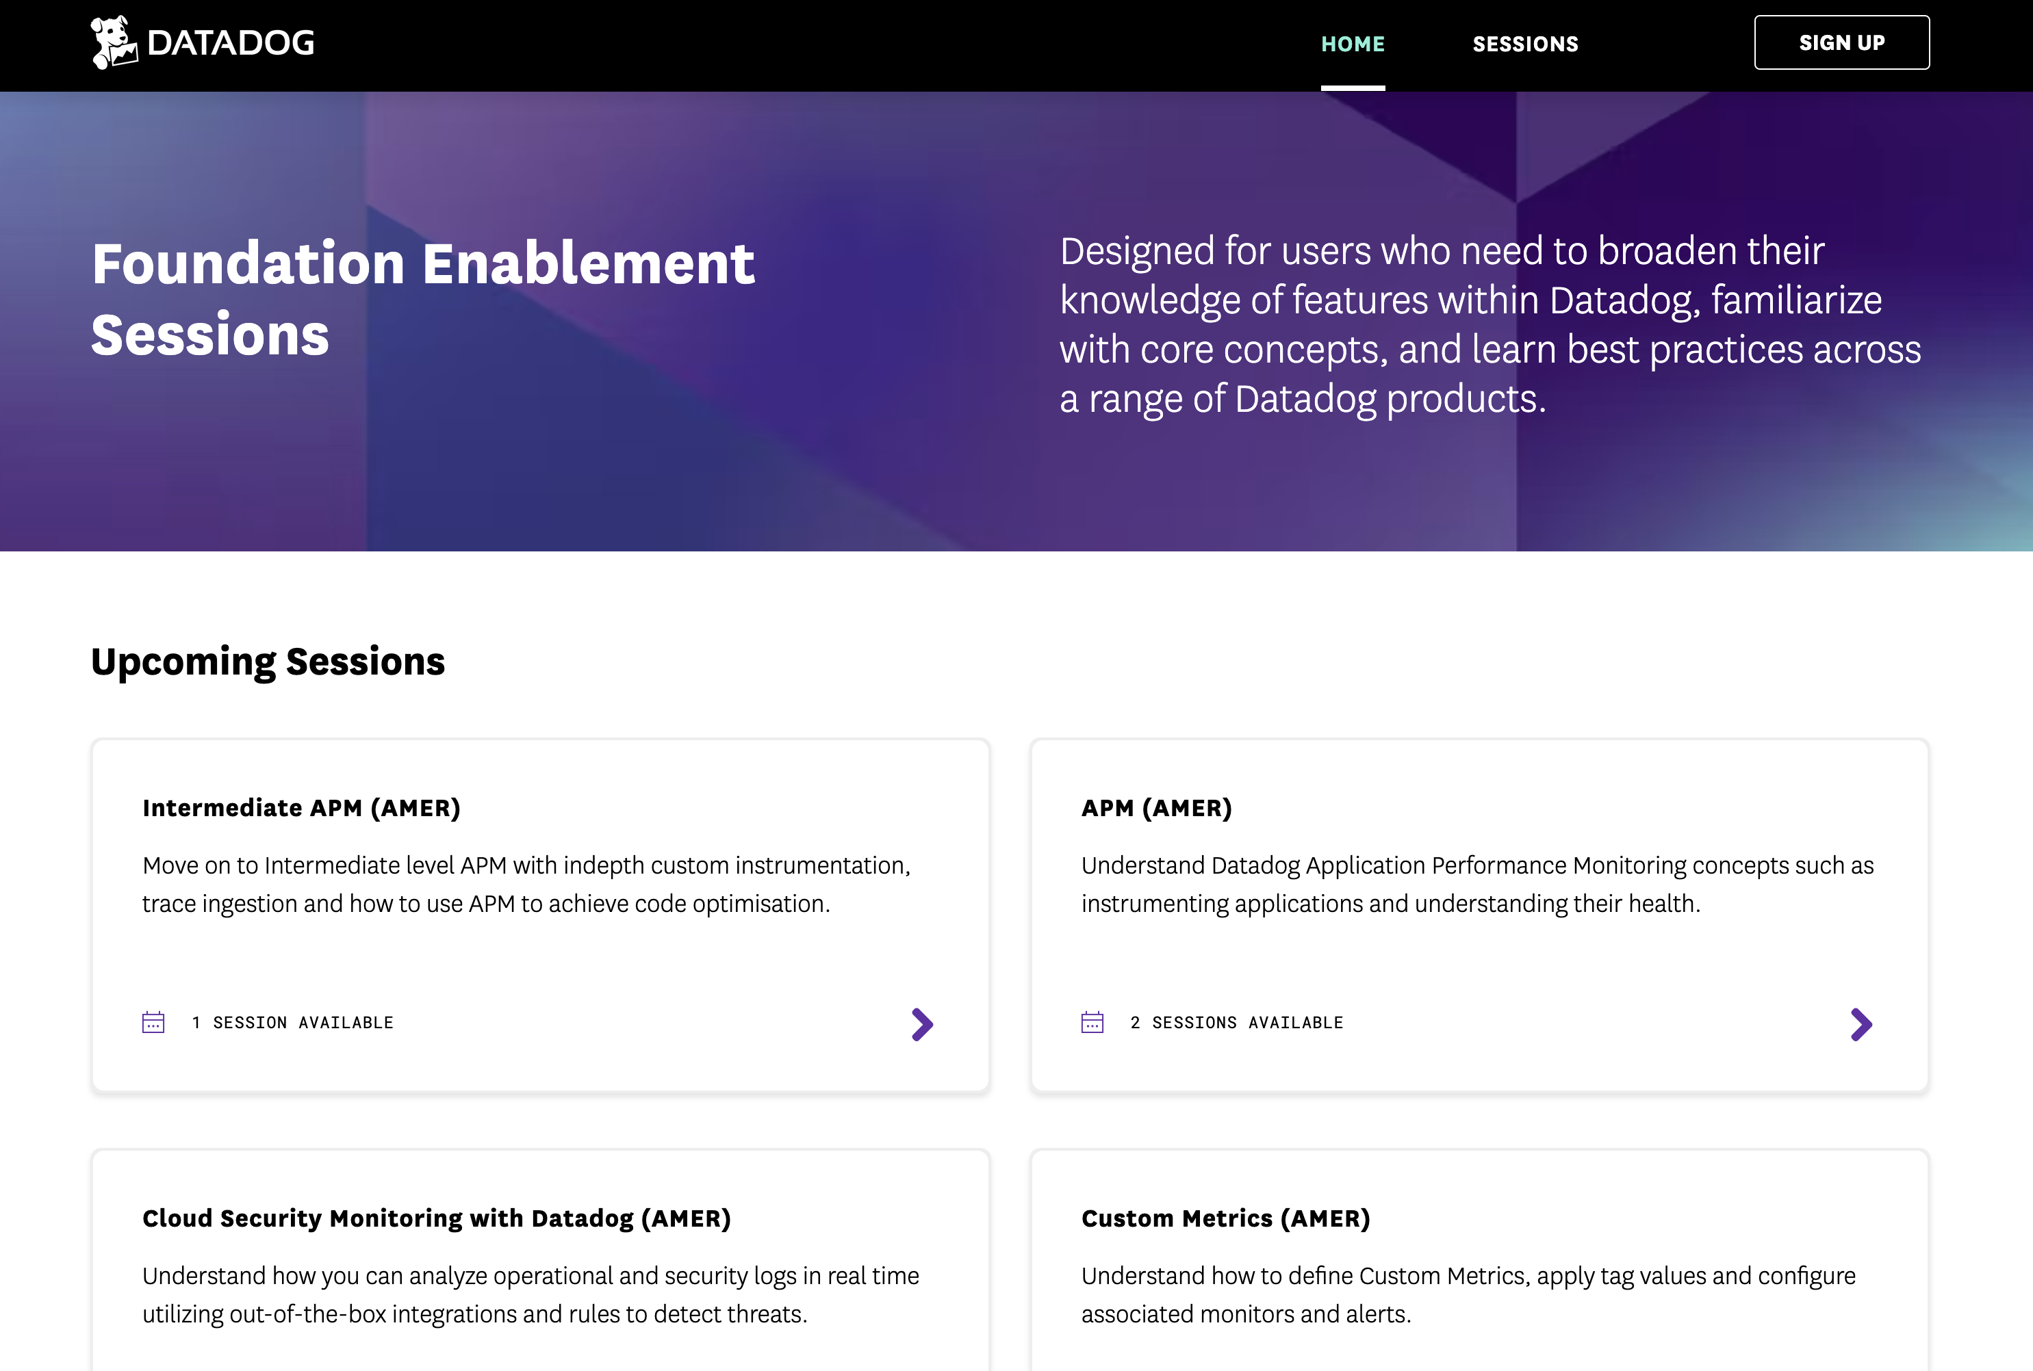
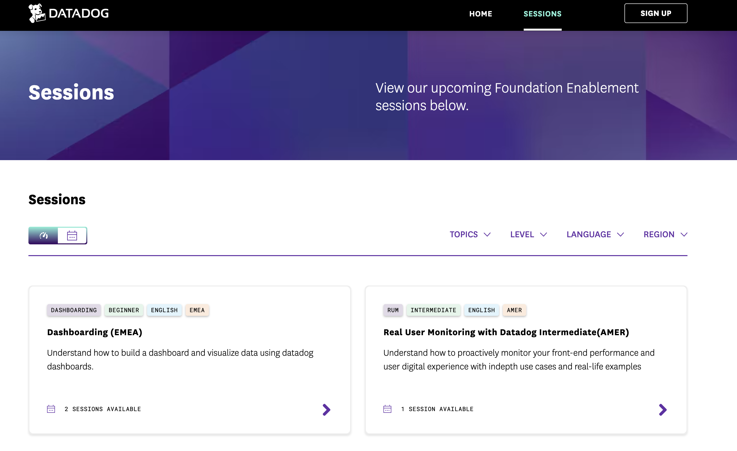
Datadog workshops
https://www.datadoghq.com/technical-enablement/

Slide 69
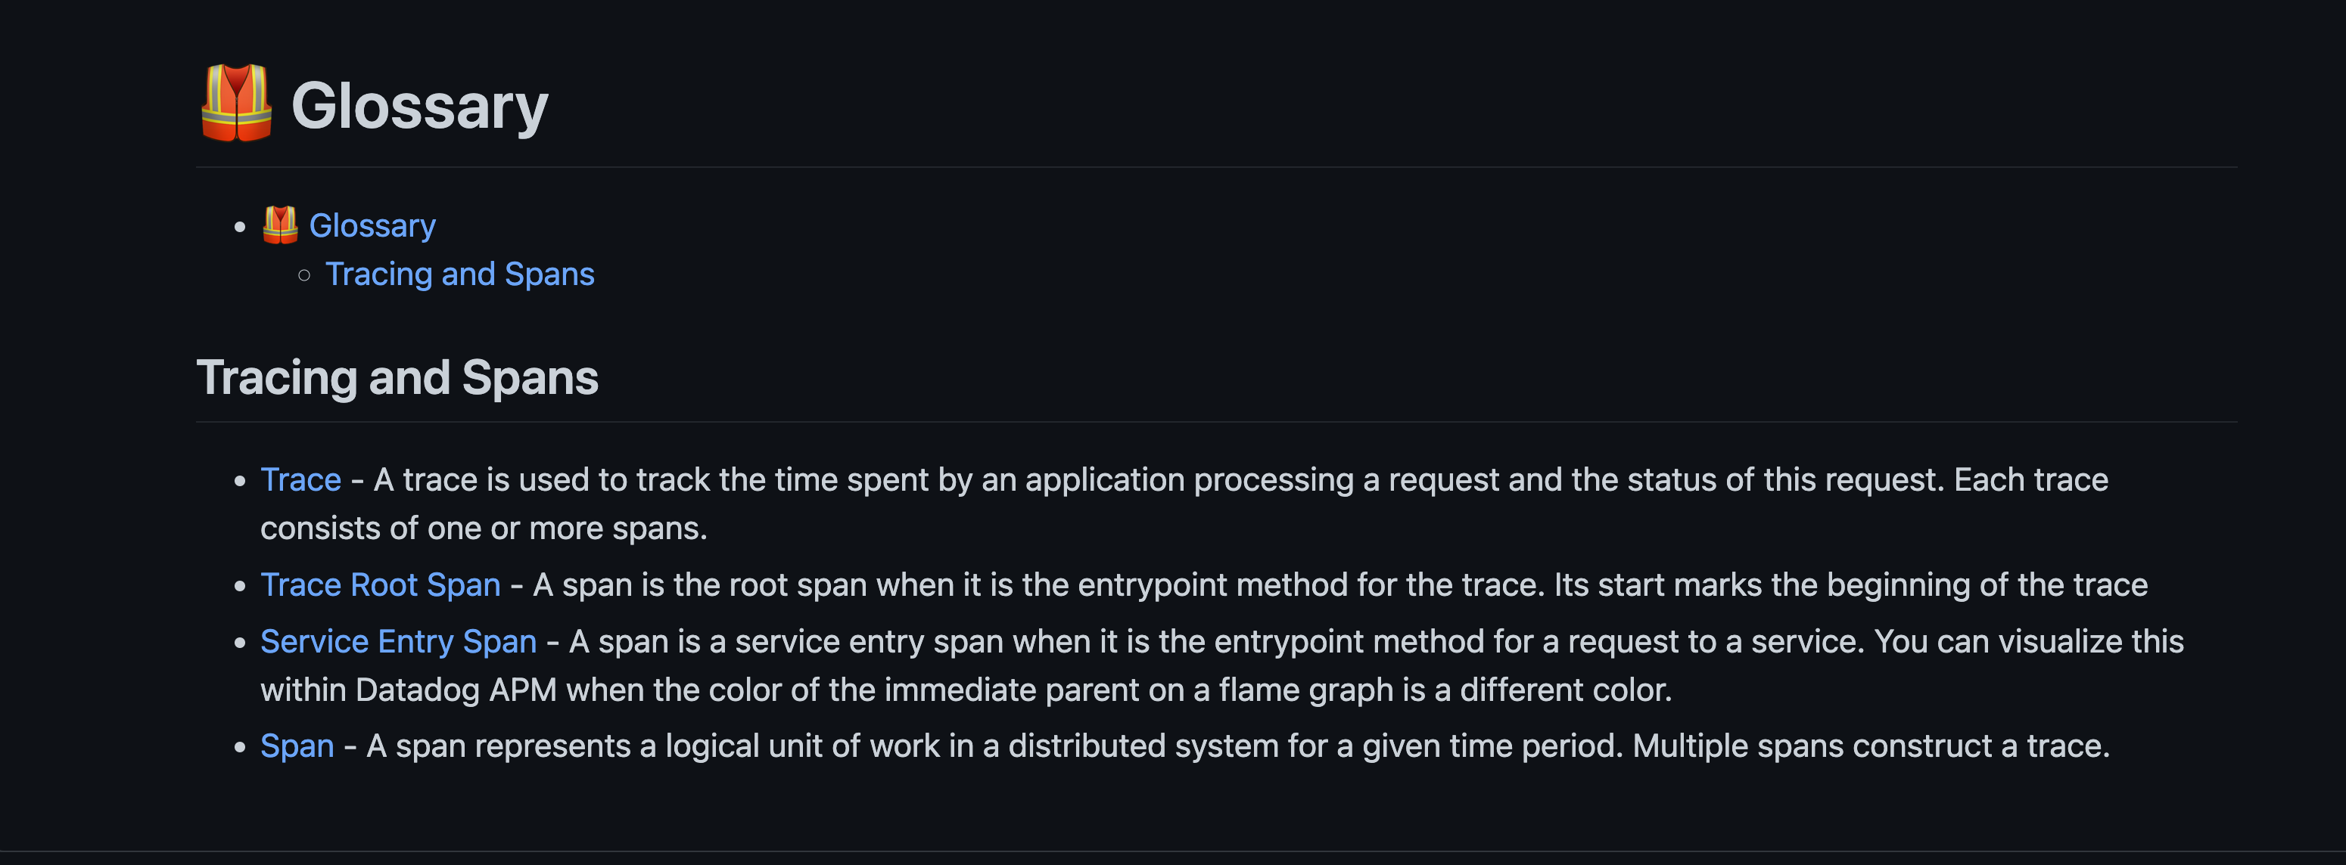

Slide 70
Learn how to ask questions.

Slide 71
Operating & Observability
👉
👉
👉
👉
👉
👉
👉

Slide 72
O11y is not about logs and alerts

Slide 73
1. Instrument code
2. Make sense
3. Make visible

Slide 74
Be curious

Slide 75
Software that works (and you know it)

Slide 76
Thanks!

